Slide 1
AUTOMATIC ATTENDENCE SYSTEM
Submitted in the partial fulfillment for the award of the degree of
BACHELOR OF ENGINEERING
IN
IBM CLOUD COMPUTING CSE (CC-1)
Submitted by:
SRAJAN AGARWAL
19BCS4021
Under the Supervision of:
MRS. AKWINDER KAUR
Department of AIT-CSE
DISCOVER . LEARN . EMPOWER

Slide 2
Outline
Introduction to Project
Problem Formulation
Objectives of the work
Methodology used
Results and Outputs
Conclusion
Future Scope
References

Slide 3
Introduction to Project
This project is aimed at developing the attendance to be taken automatically without any physical processing.
The System will use the camera for recognition and it will keep a record of the person with time stamp.
It can take place of the manual attendance system in all the organization, But at present as an example we have decided to refer the system for Educational Attendance system for better understanding.
This system is very fast and efficient that with in a second it can recognize multiple faces visible in the camera and store them with there Unique id and time stamp.
Some famous technologies it is using are
-> Artificial Intelligence
->Machine Learning
->Database (Localhost)

Slide 4
The software used in this project.
-Pycharm (Python IDE)
-Xampp Server(Database)
-Python3.8 version
The hardware used in this project.
-Device with 4+ GB RAM • 512+ GB ROM
-HD Camera.
- Graphic Card

Slide 5
Problem Formulation
Issue with the storing of recognized faces and there marked attendance, It is a great issue to handle the large amount of data generated due to which it’s efficiency is lacking.
Another issue was how to make the student mandatory to attend the session for at least 40 -45 min out of 50 min, Because the issue was if the student enter the class after 20 min then also it’s attendance was marked.
One more issue we faced that if the face of the student is changed, suppose (During registration the student has no beard, and after that he has kept the beard), wearing and non-wearing of specs, Twins.

Slide 6
Objectives
* The main objective of our project is to construct a face detection system which reduces manual efforts and provide the most efficient and smooth attendance system.
* This research helps to save time.
* We keep a motive to eradicate expenses spent on taking attendance.
* It prevents mal activities such as proxy.
* It provides the record at any instance of time.

Slide 7
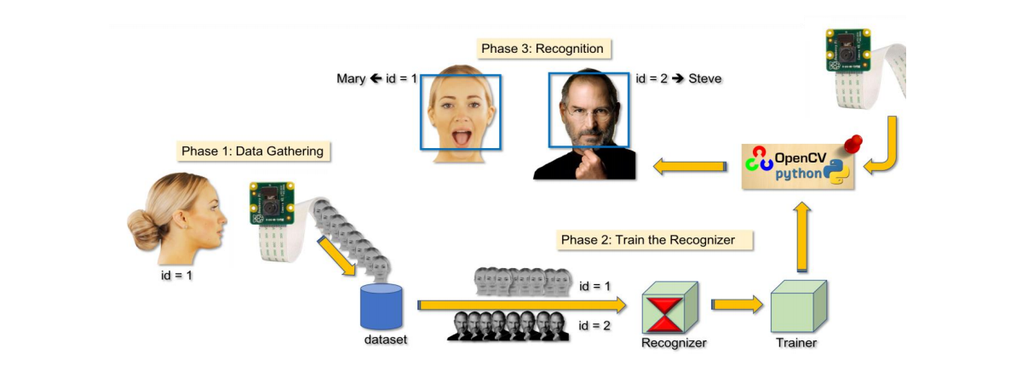
Methodology used

Slide 8
This project is equipped with some of the latest technologies and software such as Pycharm and XAMPP server.
This project even consists of tkinter it is GUI frame work of python for the presentation of our work.
For the face and eye recognition we are using LBPH algorithm.
Using xampp server as a data base for python programing, we are using opencv is one of the frame work of the python to capture the screen shot and operating the camera.
In this project we are using the CCTV cameras that is having high capacity to scan the faces.
.txt sheets to store the data of the faces captured by the camera and then the attendance will be marked automatically.

Slide 9
Results and Outputs
This Software has been proposed for maintaining the attendance record. The main motive behind the implementation of this software is to remove all the drawbacks which have been related to manual attendance machine.
Our project on Automatic Attendance System is working as per our expectations and this will be turned out to be the most remarkable project we ever made.
To Tackle the issue of large data we have created it as a real time multi face recognition system in which we only require to store the face at the time of registration else we just store the unique id f the person detected with the time stamp.
According to the need of 40 -45 min of mandatory attendance in the class we have customised it that after starting the system it will mark the attendance for 10 min only. Suppose( teacher entered at the class for session at 9:00 and started the system then the system will mark the attendance for the student who comes in the class till 9:10.
For the third issue we faced “changes in the face” we have adjusted the system confidence level to 65%-70% from 100% this will consider around 70% changes in the face. But the rest 30% can only be handled by some more new technologies which are the Future Scope for our project.

Slide 10
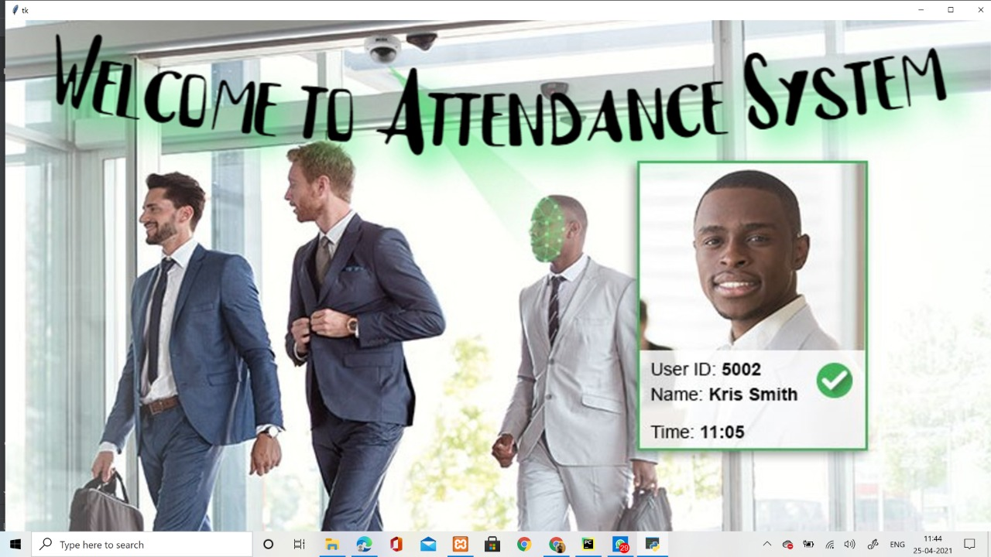
Welcome Page

Slide 11
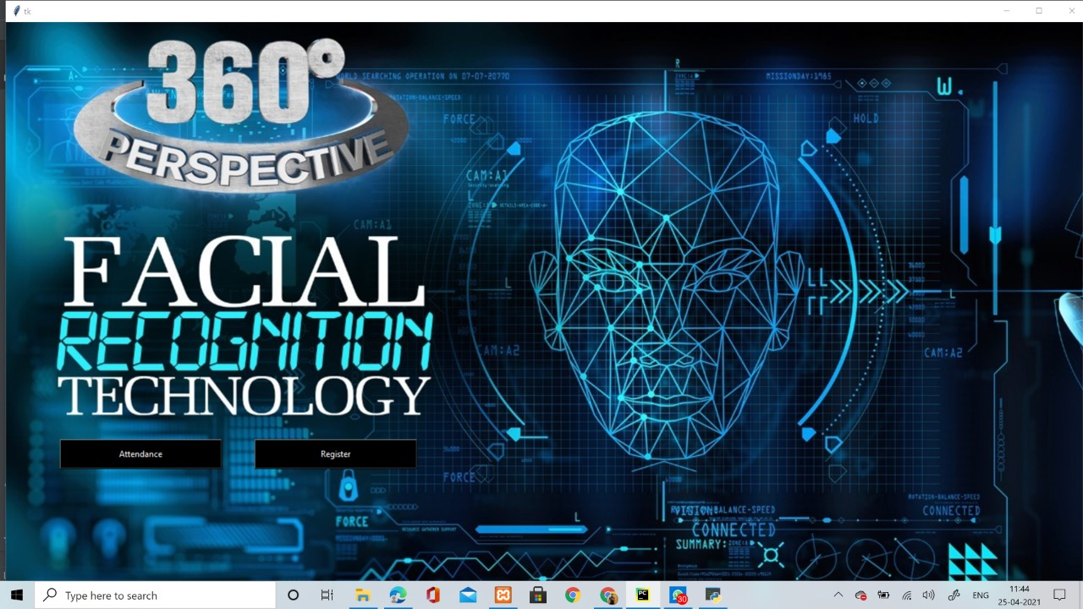
Main Dashboard page

Slide 12
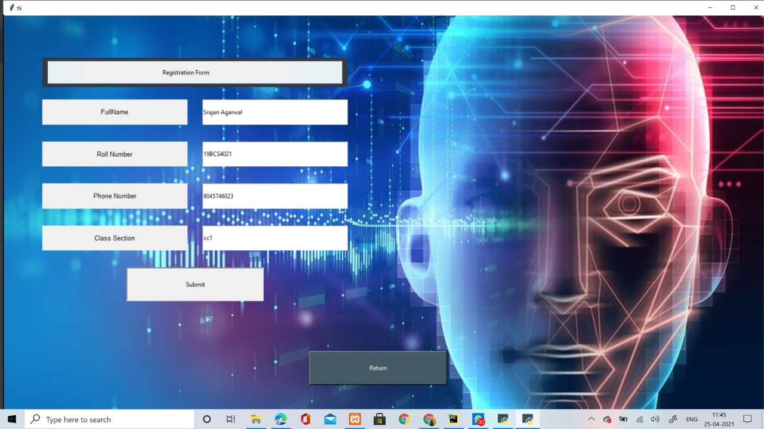
Registration Page

Slide 13
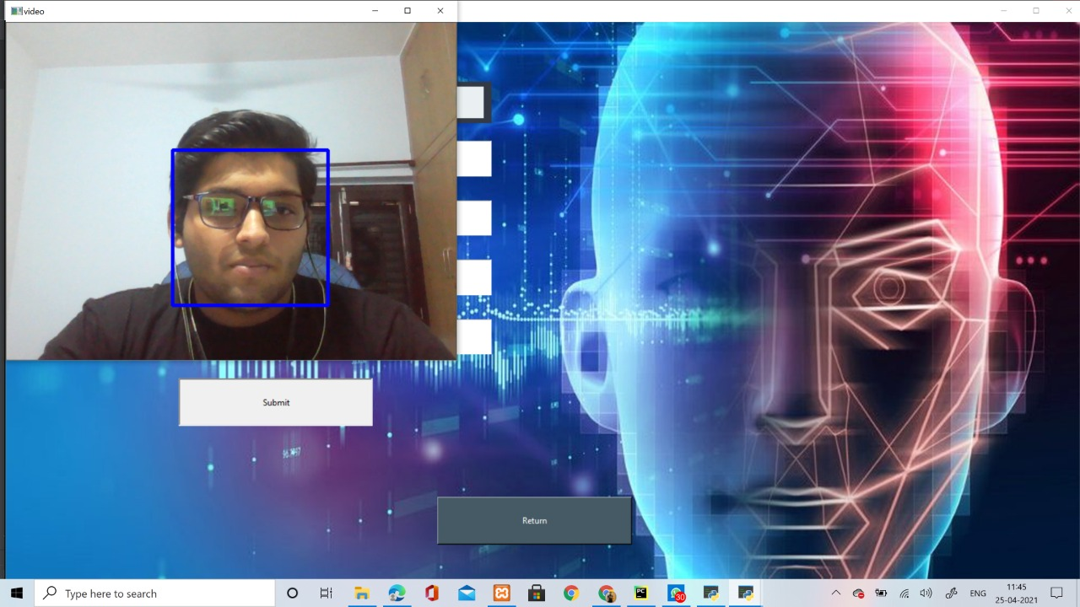
Image capturing during registration

Slide 14
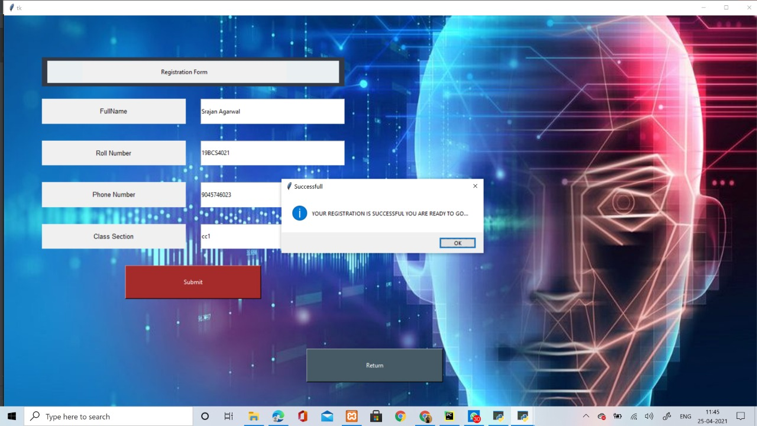
Registration confirmation

Slide 15
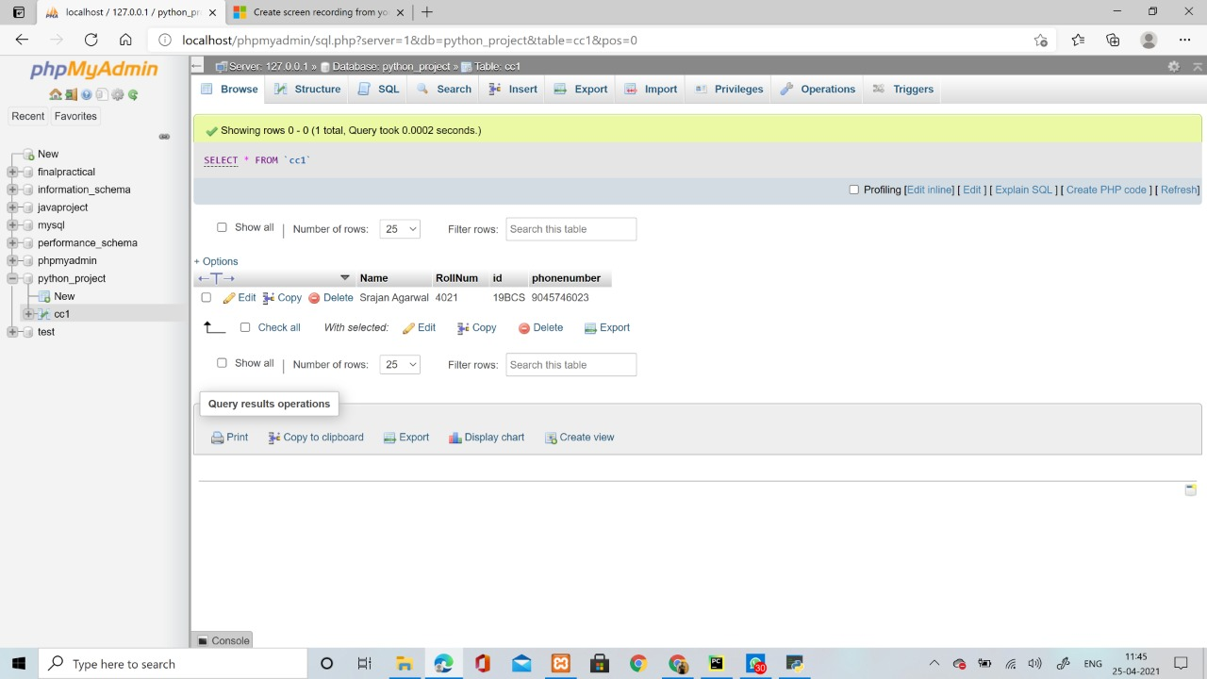
Details Successfully Added In Database

Slide 16
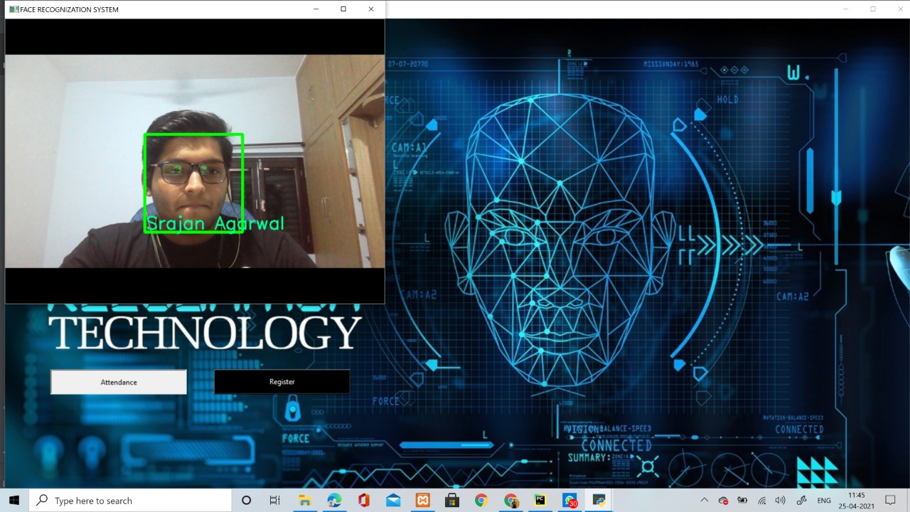
Successfully recognizing the registered person

Slide 17
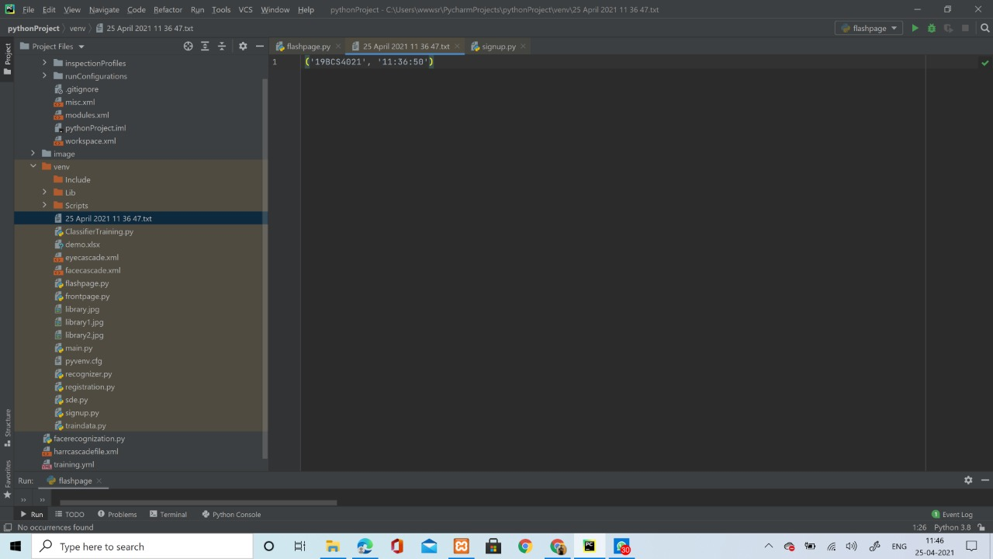
Attendance Marked in the file

Slide 18
Conclusion
It has become appallingly obvious that our Technology has exceeded
our Humanity. In this fast growing world, Time is the most precious
treasure of we humans.
In this project we have attempted to minimize the time
wasted in taking attendance. This solution is very fruitful in a long run.
We have implemented every possible contents to make it the ultimate
Attendance System till date.

Slide 19
Future Scope
Still there are some future scope to this which we could work upon in order to overcome our drawbacks and update our system in the future such as :
1. IRIS Detection.
2. Twins Detection.
3. Level based Administration.
4. And lastly System Security.
5. Complete Cloud Based System.

Slide 20
References
• Adelson, E. H., and Bergen, J. R. (1986) The Extraction of Spatio-Temporal Energy in Human and Machine Vision, Proceedings of Workshop on Motion: Representation and Analysis (pp. 151-155) Charleston, SC; May 7-9.
• Baron, R. J. (1981). Mechanisms of human facial recognition. International Journal of Man Machine Studies, 15:137-178.
• Beymer, D. and Poggio, T. (1995) Face Recognition From One Example View, A.I. Memo No. 1536, C.B.C.L. Paper No. 121. MIT.
• Goldstein, A.J., Harmon, L.D., and Lesk, A.B. (1971). Identification of human faces. In Proc. IEEE, Vol. 59, page 748.

Slide 21
• Bichsel, M. (1991). Strategies of Robust Objects Recognition for Automatic Identification of Human Faces. PhD thesis, , Eidgenossischen Technischen Hochschule, Zurich.
• Brennan, S. E. (1982) The caricature generator. M.S. Thesis. MIT.
• Brunelli, R. and Poggio, T. (1993), Face Recognition: Features versus Templates. IEEE Transactions on Pattern Analysis and Machine Intelligence, 15(10):1042-1052.
• Craw, I., Ellis, H., and Lishman, J.R. (1987). Automatic extraction of face features. Pattern Recognition Letters, 5:183-187, February.
• Deffenbacher K.A., Johanson J., and O'Toole A.J. (1998) Facial ageing, attractiveness, and distinctiveness. Perception. 27(10):1233-1243.
• Dunteman, G.H. (1989) Principal Component Analysis. Sage Publications.Frank.

Slide 22
• H. and Althoen, S. (1994). Statistics: Concepts and applications. Cambridge University Press. p.110.
• Gauthier, I., Behrmann, M. and Tarr, M. (1999). Can face recognition really be dissociated from object recognition? Journal of Cognitive Neuroscience, in press.
• de Haan, M., Johnson, M.H. and Maurer D. (1998) Recognition of individual faces and average face prototypes by 1- and 3- month-old infants. Centre for Brain and Cognitive Development, Department of Psychology, Birkbeck College.

